Slide 1
Intro to R and R Markdown
DSC 152 Discussion – Week 1
Acknowledgement: Lucas Venetoulias

Slide 2
Agenda
Quick discussion of R and RStudio’s setup, R Markdown files
Quick install of R and RStudio
Live demos/coding in R
Demo knitting code in R Markdown

Slide 3
R and RStudio
R – programming language, where you do computations.
RStudio – IDE (interface), where you can write / run R Code.

Slide 4
Installation Instructions for R
Go to www.r-project.org. Under “Getting Started”, click on "download R".
Select a location from which you will download R (these are called CRAN mirrors); I would choose a site within the US. If one location is having trouble, choose another.
Click on the download appropriate for your operating system (Linux, macOS, Windows).
If you chose Windows in step 3), then you’ll want to click on “install R for the first time”, and then “Download R 4.6.1 for Windows” (or whatever the most recent version number is when you are reading these instructions). If you chose macOS in step 3), then you’ll click on R-4.6.1.pkg near the bottom of the screen. At the end of this step, you should be downloading a file containing the R language.
Once the file is downloaded, you can double-click it and begin the installation process. When you’re done installing R, then you need to download and install RStudio.

Slide 5
Installation Instructions for RStudio
Go https://posit.co/download/rstudio-desktop/ and go to the next step.
Scroll down a little to the “Install Links” and find the Installer file appropriate for your operating system.
Once the file is downloaded, you can double-click it and begin the installation process. When you’re done installing RStudio, you should be able to run RStudio and type print(“Hello World”) in the console.
After hitting enter, you should get [1] “Hello World”.

Slide 6
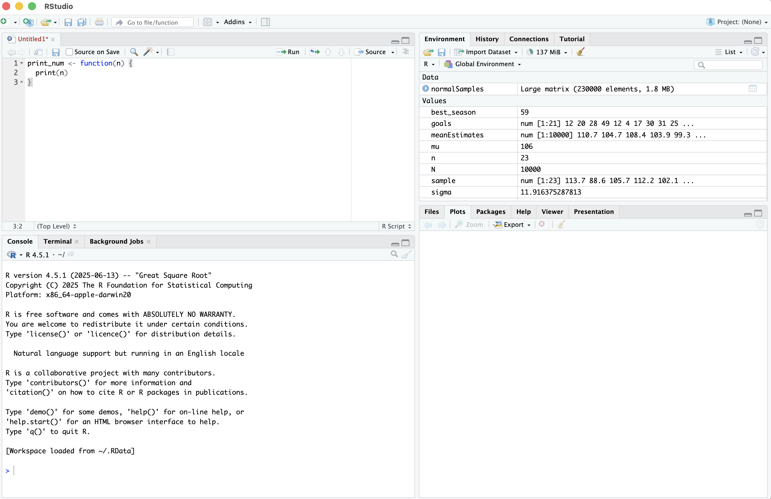
Typical Setup in RStudio
Script editor
Environment
Files/Plots/Packages
Console (terminal)
Notes:
Header: "Getting Oriented in RStudio" Content: Very little text — the screenshot does the work here. Just label the four panes:
Top-left: Script Editor — where you write code
Bottom-left: Console — where code runs
Top-right: Environment — your variables and data live here
Bottom-right: Files / Plots / Help
Screenshot: A full screenshot of RStudio with colored boxes or arrows pointing to each pane and a one-word label on each. This is the most important visual in the deck — spend a little time making it clean.

Slide 7
Directories and Packages
Working Directory:
Folder R ‘looks in’ by default.
Check it with getwd().
Set/change it with setwd(‘path/to/folder’).
Set/change it in RStudio’s menu (Session → Set Working Directory → Choose Directory…).
Packages (like those in Python):
Bundles of extra functions written by community .
Install each package once: install.packages(“ggplot2”).
Load necessary packages in each session: library(ggplot2).
Packages lives on CRAN (‘app store’ for R).

Slide 8
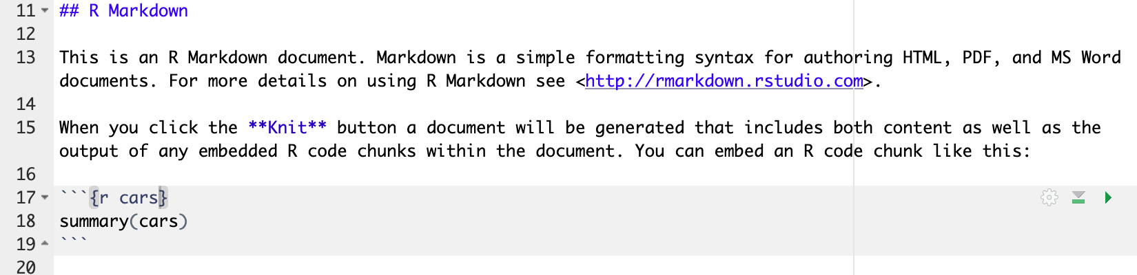
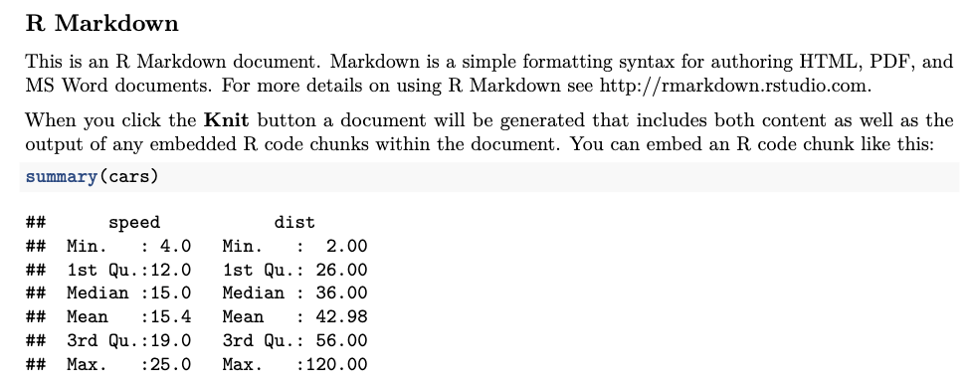
R Markdown
.Rmd file combines text, code, LaTex, and outputs into one file.
Knit is how RStudio runs code and compiles everything into a file (pdf, docx, HTML, etc.).
We ask you submit your HWs via R Markdown files in .pdf format.
Raw .Rmd file content
Produced output in PDF

Slide 9
R Markdowns & LaTex
Knitting R Markdown files in .pdf format requires local LaTex compiler.
Local LaTex installation is difficult because of size.
Easiest solution is tinytex (more lightweight LaTex distribution designed for R).
Install once with two commands:
  install.packages(“tinytex”)
  tinytex::install_tinytex()
After this, knitting works as intended.

Slide 10
Installation
Install R, Rstudio, R Markdown, and TinyTeX.

Slide 11
R Demo
Demonstration of basic R codes.

